Slide 1
The cell biology lab 11

Slide 2
Peroxisomes and their functions
A type of organelle found in both animal cells and plant cells, a peroxisome is a membrane-bound cellular organelle that contains mostly enzymes . Peroxisomes perform important functions, including lipid metabolism and chemical detoxification.

Slide 3
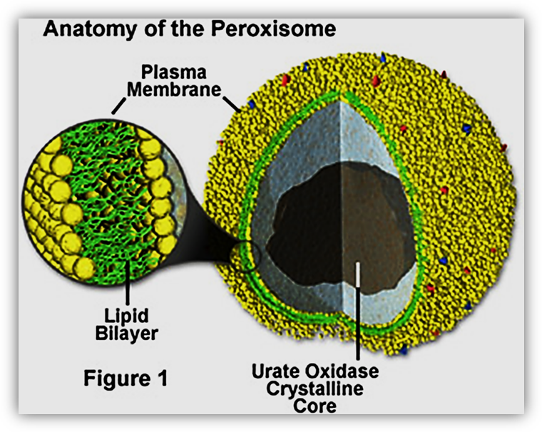

Slide 4
also carry out oxidation reactions the certain enzymes within the peroxisome, by using molecular oxygen, remove hydrogen atoms from specific organic substrates (R), and producing hydrogen peroxide (H2O2, itself toxic):
RH2 ₊ O2 ---------- R+ H2O2

Slide 5
another peroxisomal enzyme, uses this H2O2 to oxidize other substrates, including phenols, formic acid, formaldehyde, and alcohol, by means of the peroxidation reaction:
H2O2 + R’ H2------------ R’ + 2H2O
Thus eliminating the poisonous hydrogen peroxide in the process.

Slide 6
This reaction is important in liver and kidney cells, where the peroxisomes detoxify various toxic substances that enter the blood. About 25% of the ethanol humans drink is oxidized to acetaldehyde in this way. In addition, when excess H2O2 accumulates in the cell, enzyme catalase converts it to H2O through this reaction:
2H2O2---------- 2H2O2 + O2

Slide 7
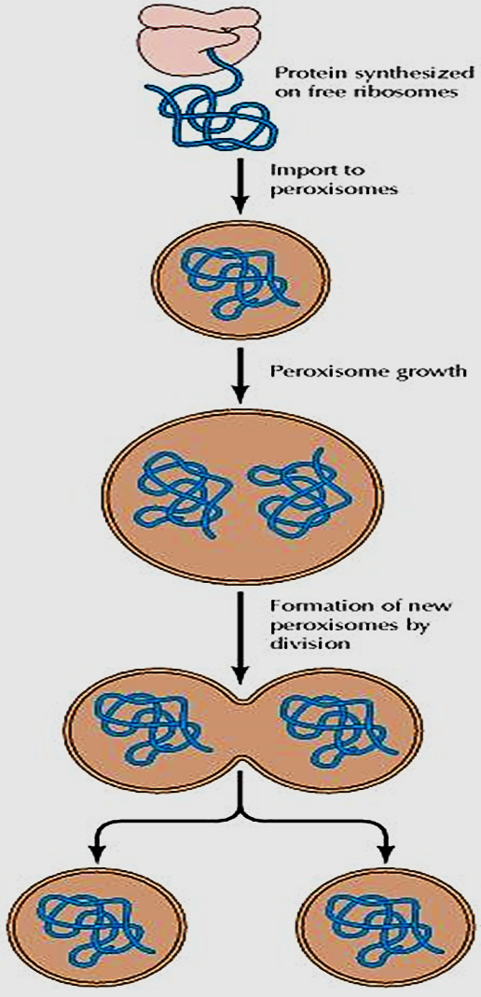

Slide 8
Peroxisomes are morphologically similar to lysosomes, they are assembled, like mitochondria and chloroplasts, from proteins that are synthesized on free ribosomes and then imported into peroxisomes as completed polypeptide chains. Although peroxisomes do not contain their own genomes, they are similar to mitochondria and chloroplasts in that they replicate by division.

